Slide 1
Public Sentiment on Social Media in Response to Receiving a Covid Vaccine
Noah Sheldon
ab20962

Slide 2
Motivations
Covid Pandemic
Availability of Social Media Data
Advances in Natural Language Processing(NLP)

Slide 3
Project objectives
Collection of Twitter data using tweepy API.
Visualization of the collected data.
Pre-processing the collected data.
Performing topic modelling on pre-processed data.
Visualizing the results of topic modelling.
Performing classification of the data.

Slide 4
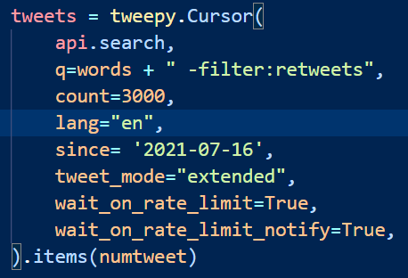
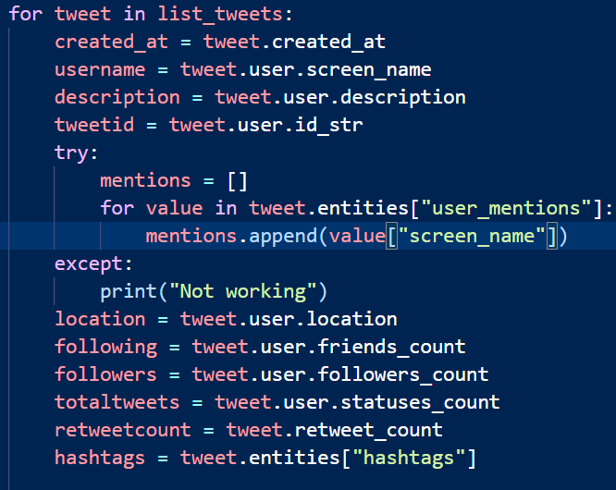
Data collection
Using tweepy API
Storing Twitter Data

Slide 5
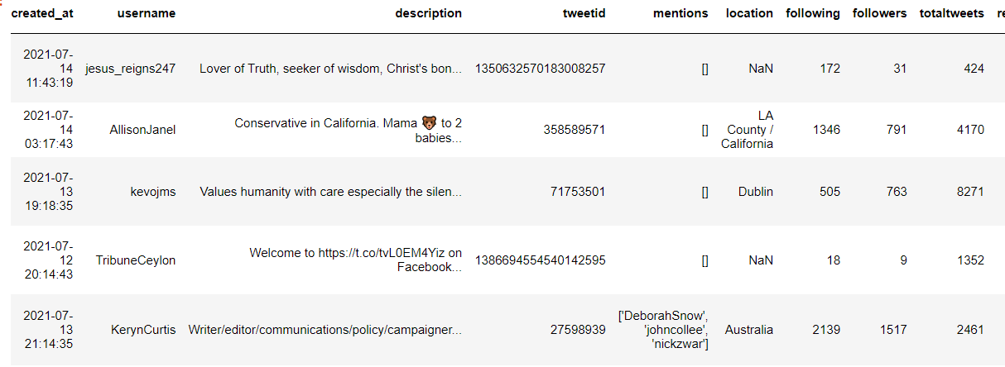
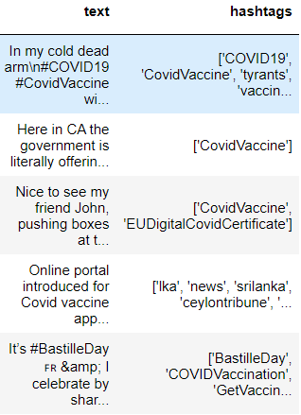
Data Dictionary/ Data frame

Slide 6
Data pre-processing
Removing links, hashtags, and mentions
Tokenization
Removing stop words
Lemmatization

Slide 7
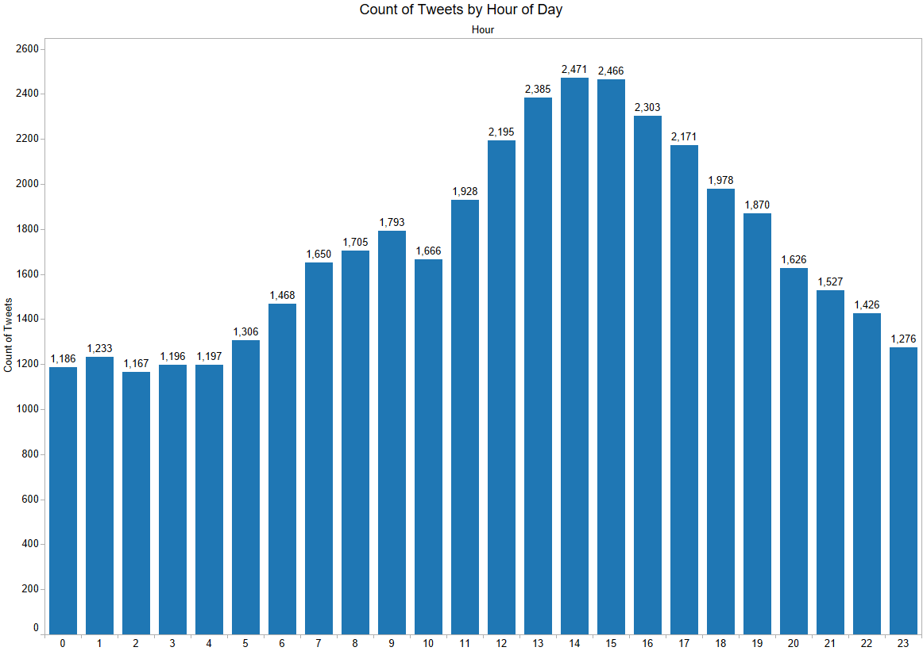
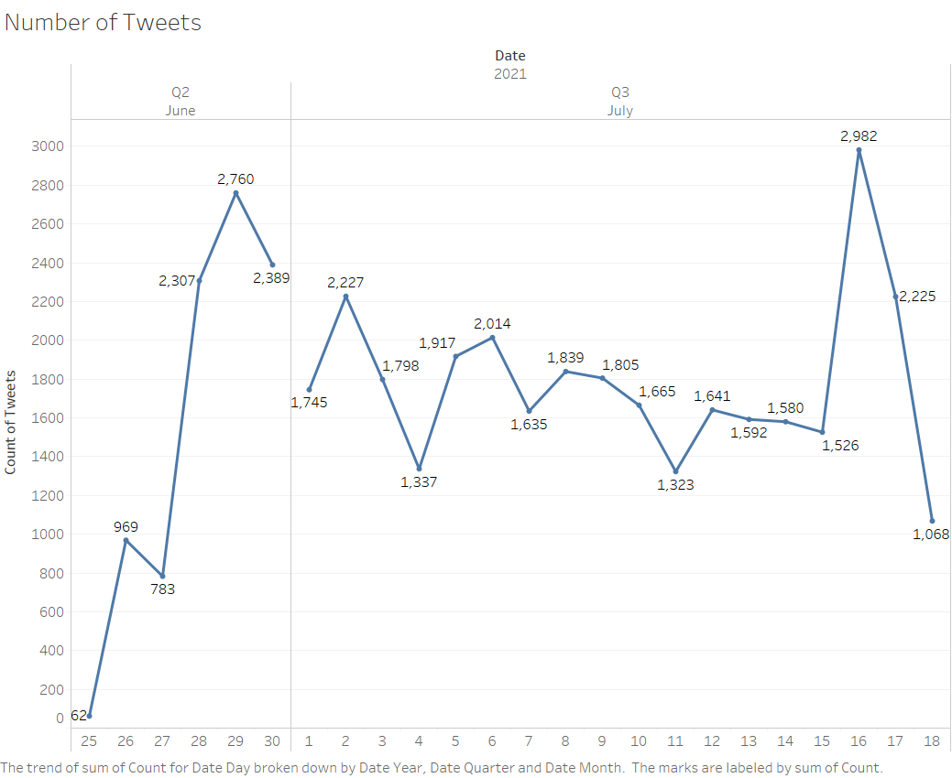
Number of tweets by Date and hour

Slide 8
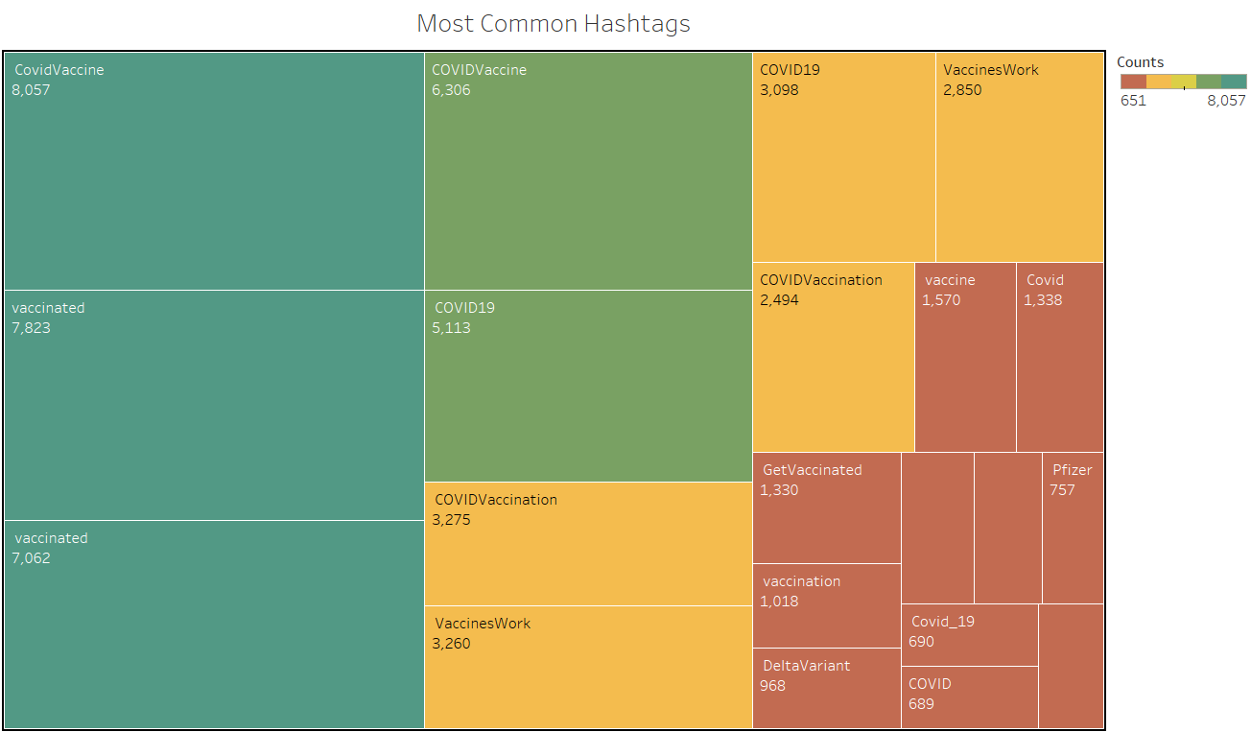
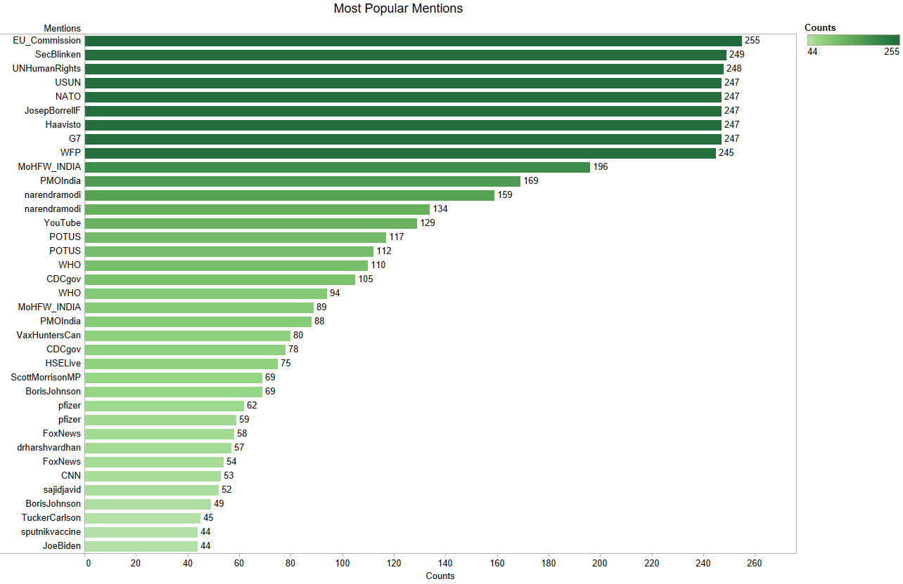
Most common hashtags and mentions

Slide 9
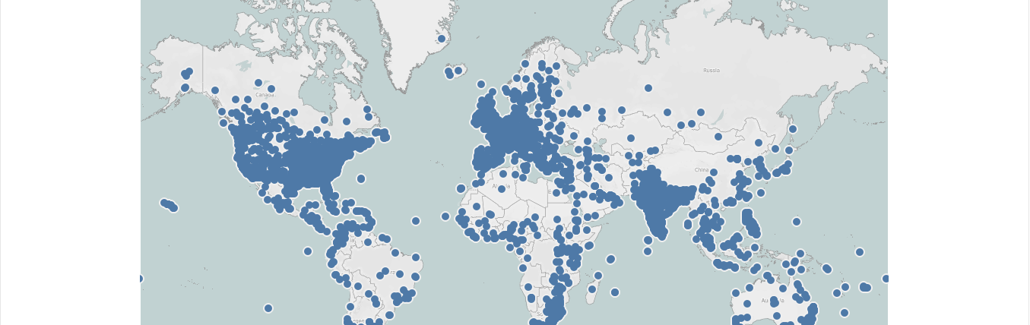
Tweets by geographic location

Slide 10
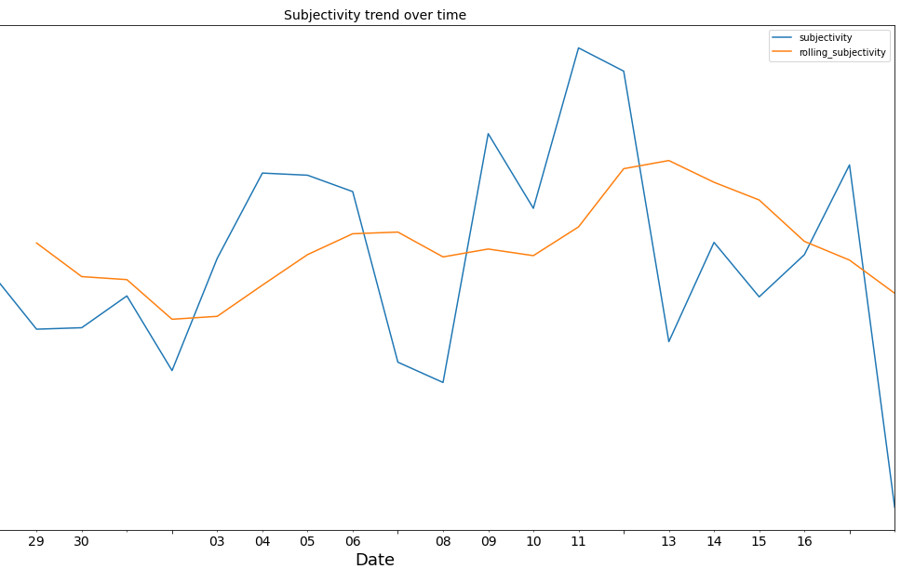
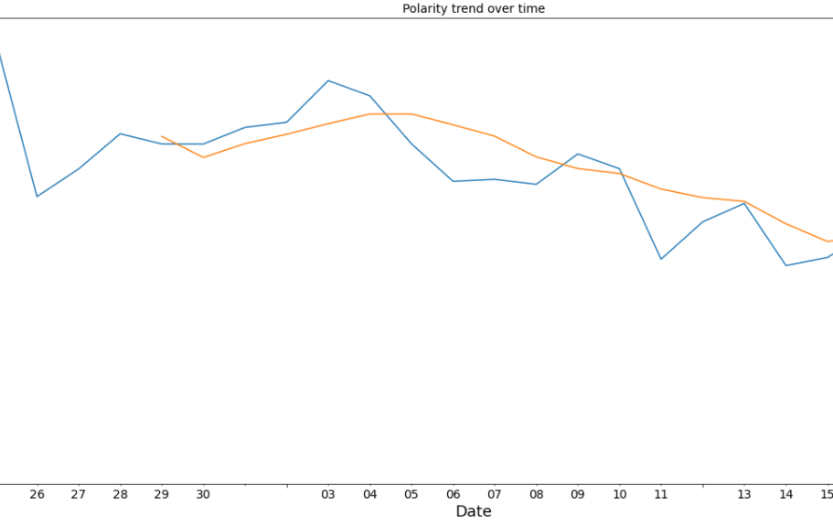
Sentiment analysis

Slide 11
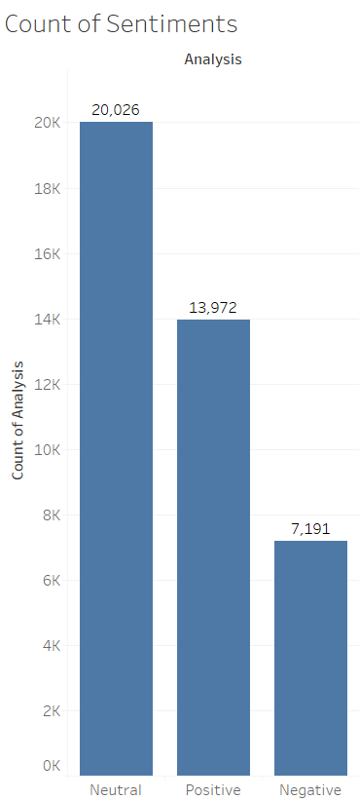
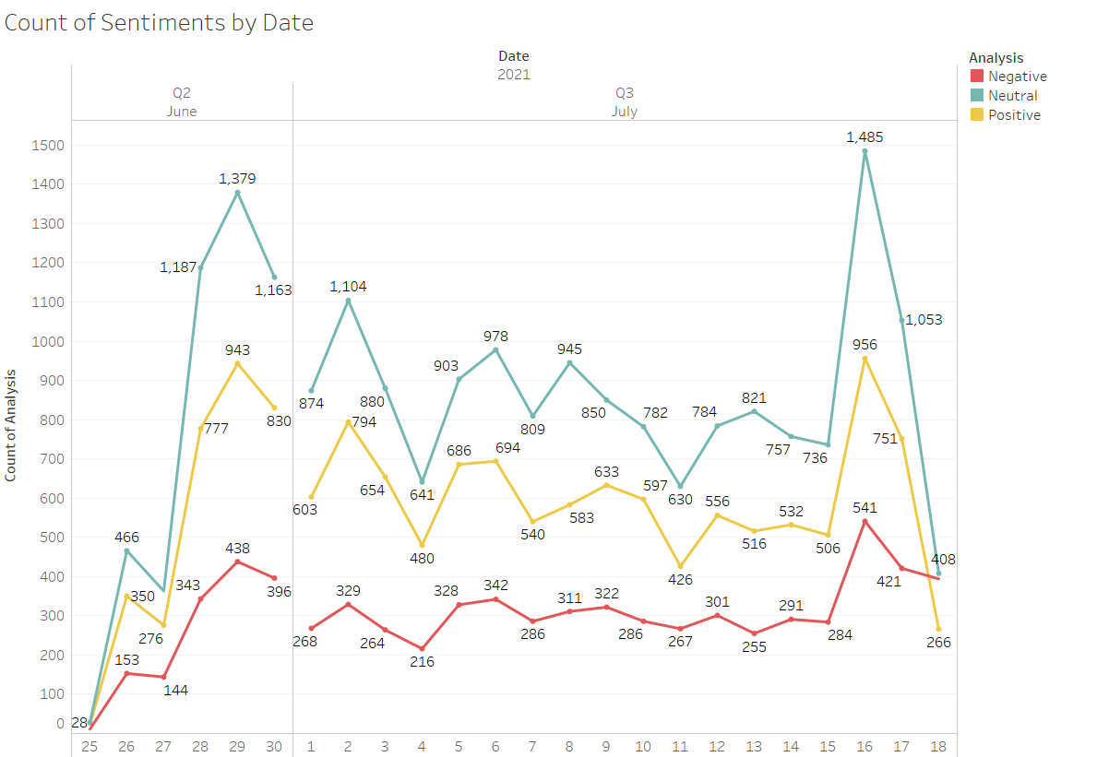
Sentiment by type

Slide 12
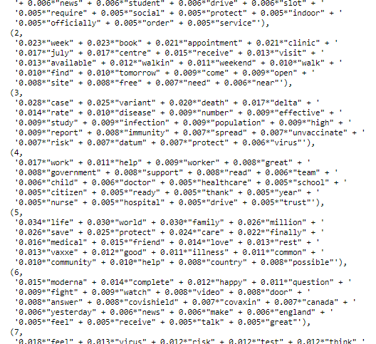
Topic modelling

Slide 13
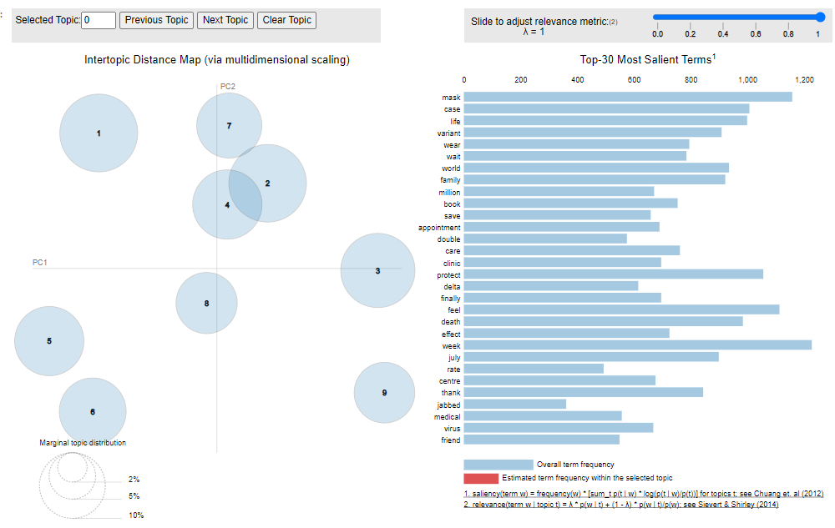
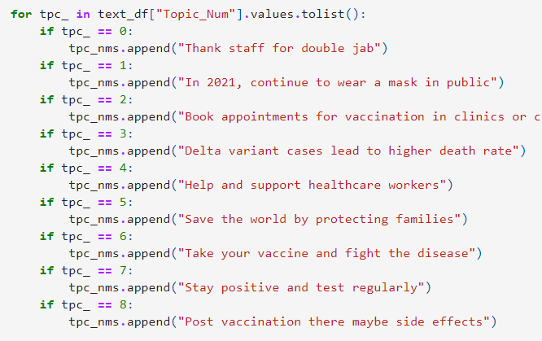
Topic modelling - results

Slide 14
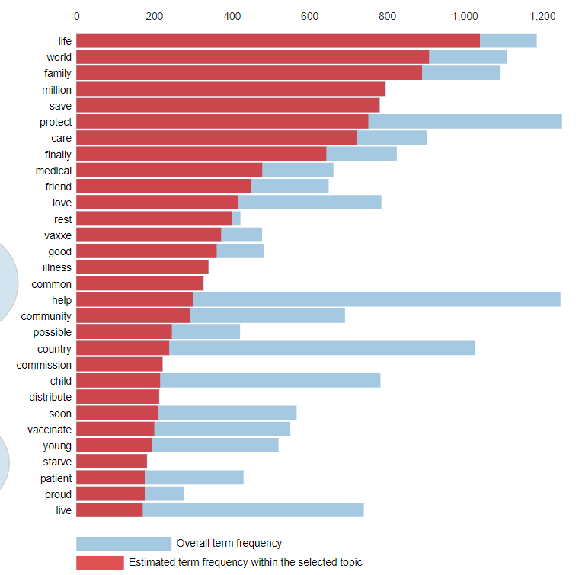
Topic modelling - results

Slide 15
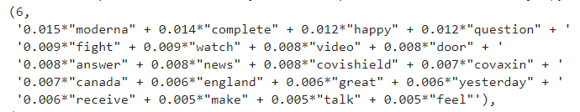
Tweets classification

Slide 16

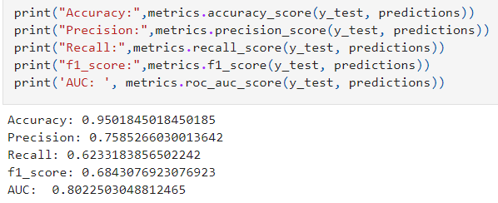
Classification results

Slide 17
Conclusion
Results can be used for further public health research
Built a full pipeline to understand public opinion

Slide 18

Thank you

